Slide 1

Mini Project-I (K24MCA18P) Odd Semester Session 2024-25
{CodeKing}
(A Social Platform for Coders)
Aman Kumar 2426MCA1782
Project Supervisor:
Ms. Divya Singhal
Assistant professor

Slide 2
Content
Introduction (1 slide)
Literature Review (2 slides)
Objective of the Project (1 slide)
Technology
Hardware Requirements (Development Environment, Server requirement (if required), Client requirement (if required).
Software Requirements (Language and Platforms like Frameworks, VS code, Android Studio and Jupyter notebook etc. )
Modules (2-3 slides)
Workflow (1 slide)
Reports (For Example: Project : Student Monitoring System, so reports like: Student Marks, Subjects, companies visit, and student appears in placement etc.)
References (1 slide)

Slide 3
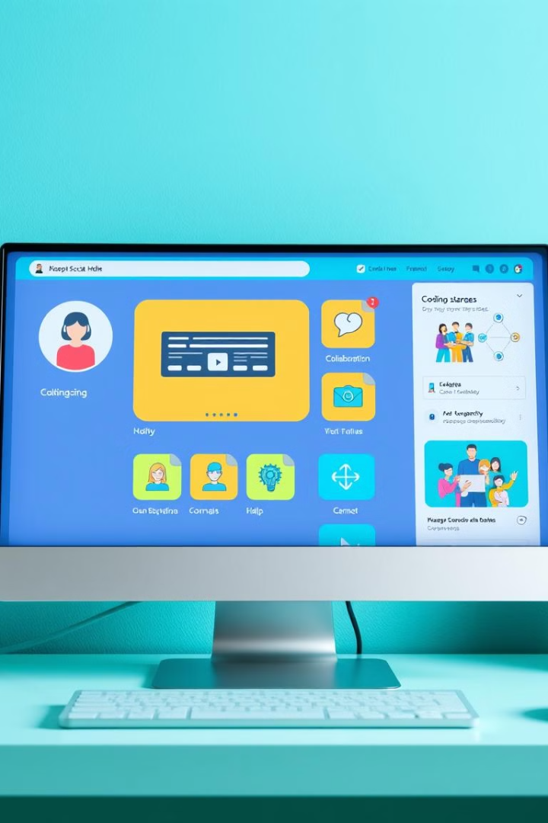
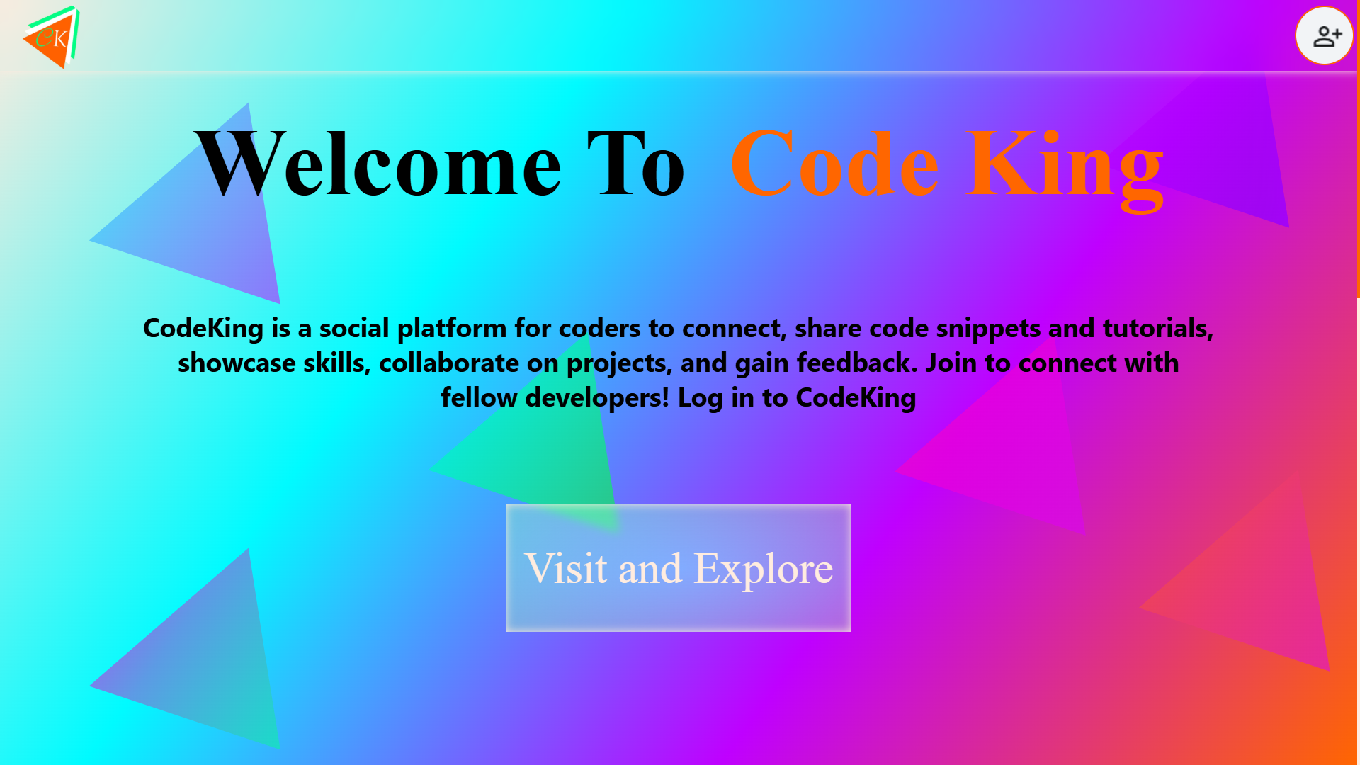
Introduction
1
Connecting Coders
2
Collaborative Learning
The platform facilitates interactions between coders, enabling them to share knowledge, seek assistance, and build professional relationships.
It fosters a community where coders can learn from each other through shared projects, code reviews, and discussions.
3
Skill Development
The platform provides opportunities for coders to enhance their skills through challenges, tutorials, and access to relevant resources.

Slide 4
Literature Review
Professional Networking & Social Media
Traditional platforms like LinkedIn enhance professional connections and career growth but lack a focus on specialized communities like coders.
Platforms like GitHub and Stack Overflow focus on code collaboration and problem-solving, but miss creative, informal interaction seen in mainstream social media.

Slide 5
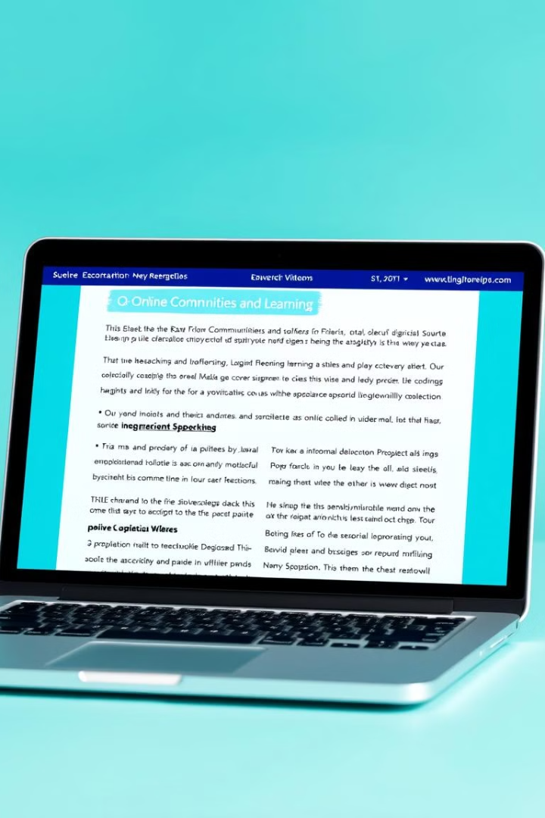


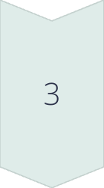
Literature Review (Contd.)
User Needs
Understanding the specific needs and preferences of coders was a crucial aspect of the literature review, guiding the platform's design and functionality.
Challenges in Developer Communities
Keeping engagement in tech communities is difficult due to the fast-changing nature of technology. Existing platforms focus more on technical content, not social creativity.
Gap in the Market
No current platform combines the creative, social aspects of platforms like Instagram with the technical depth developers need.
CodeKing fills this gap by blending a coding-focused social experience, allowing developers to showcase projects, collaborate, and network informally in a visually engaging way.

Slide 6
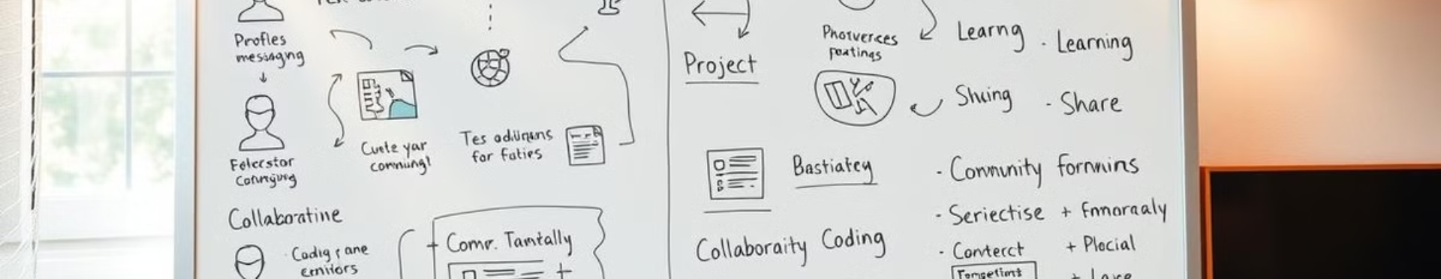
Objective of the Project
Objective 1
To create a platform that facilitates meaningful connections between coders.
Objective 2
To provide a collaborative learning environment for coders of all skill levels.
Objective 3
To offer opportunities for coders to showcase their skills and build professional portfolios.

Slide 7

Technology (Hardware Requirements)
High-Performance Servers
Networking Infrastructure
Data Storage
To handle the large amount of data and user traffic, the platform requires high-performance servers with sufficient processing power, memory, and storage capacity.
A robust networking infrastructure is essential to ensure reliable and fast communication between users and servers.
Secure and scalable data storage solutions are required to store user profiles, code repositories, and other platform-related data.

Slide 8
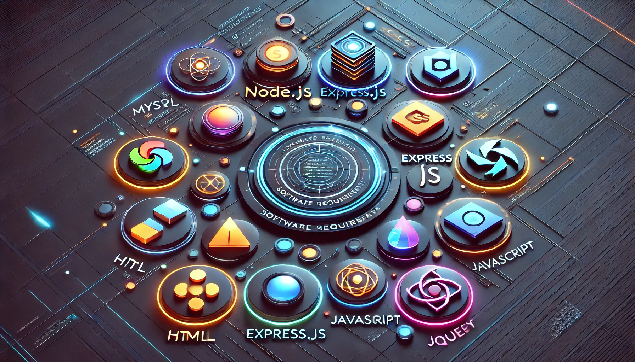




Technology (Software Requirements)
Database Management System
Web Server
A robust database management system is needed to store and manage user data, code repositories, and other platform-related information. Like MYSQL
A web server is required to host the platform's website and deliver content to users.
Programming Languages
Security Measures
A combination of programming languages, such as JavaScript, and Node.Js with express.js, will be used to develop the platform's functionalities.
Strong security measures, including encryption, authentication, and access control, are implemented to protect user data and ensure platform integrity.

Slide 9
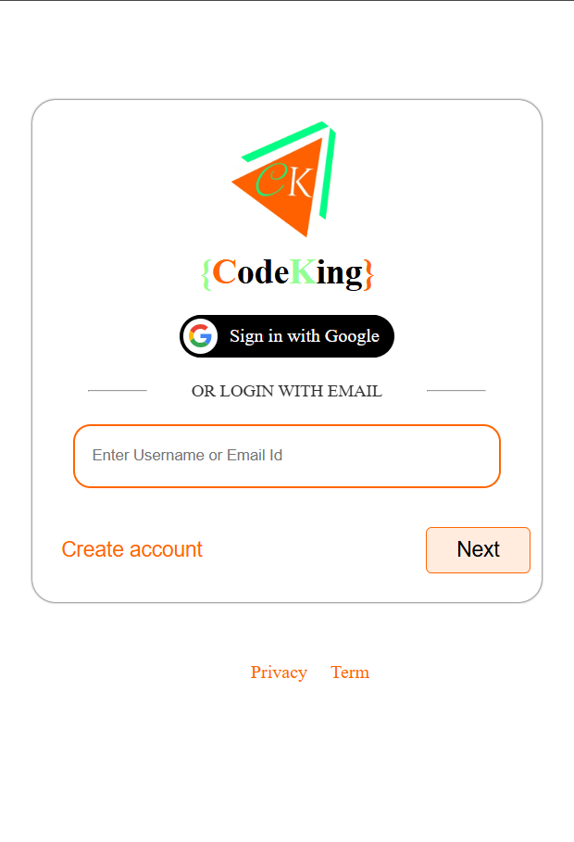
Module: 1
User Authentication
Features: Sign –up, Login, Password reset
Purpose: Secure user access and personalized experience..

Slide 10
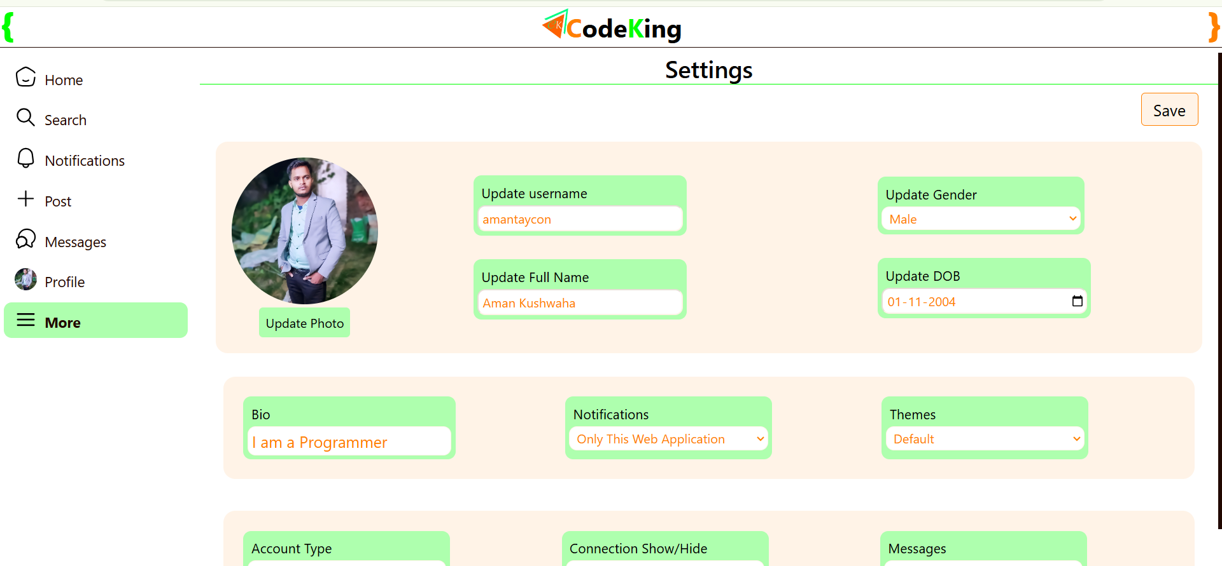
Module: 2
User Profile Management Module
Features: Profile creation, DP upload, bio, and more settings
Purpose: Allow users to manage personal information and display personalize content.

Slide 11
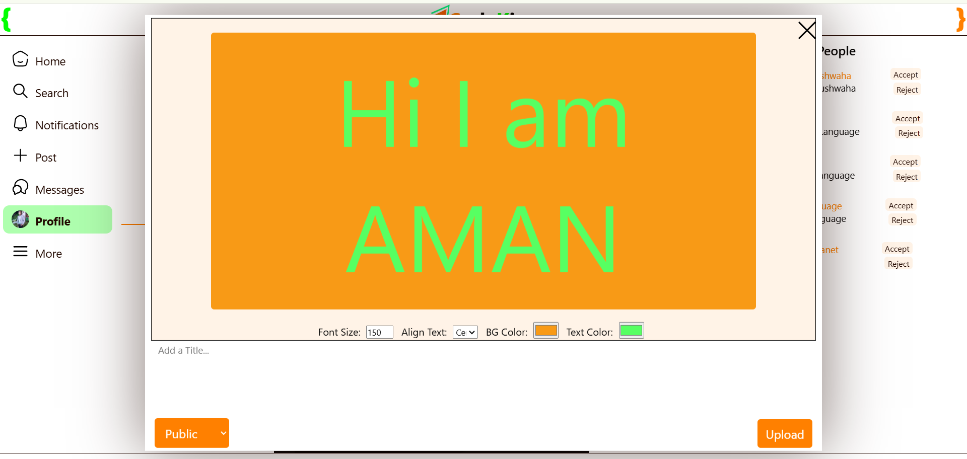
Module: 3
Post & Share Module
Features: Users can upload and share coding-related posts, project ideas, code snippets, and tutorials
Purpose: Facilitate content sharing and collaboration among the community.

Slide 12
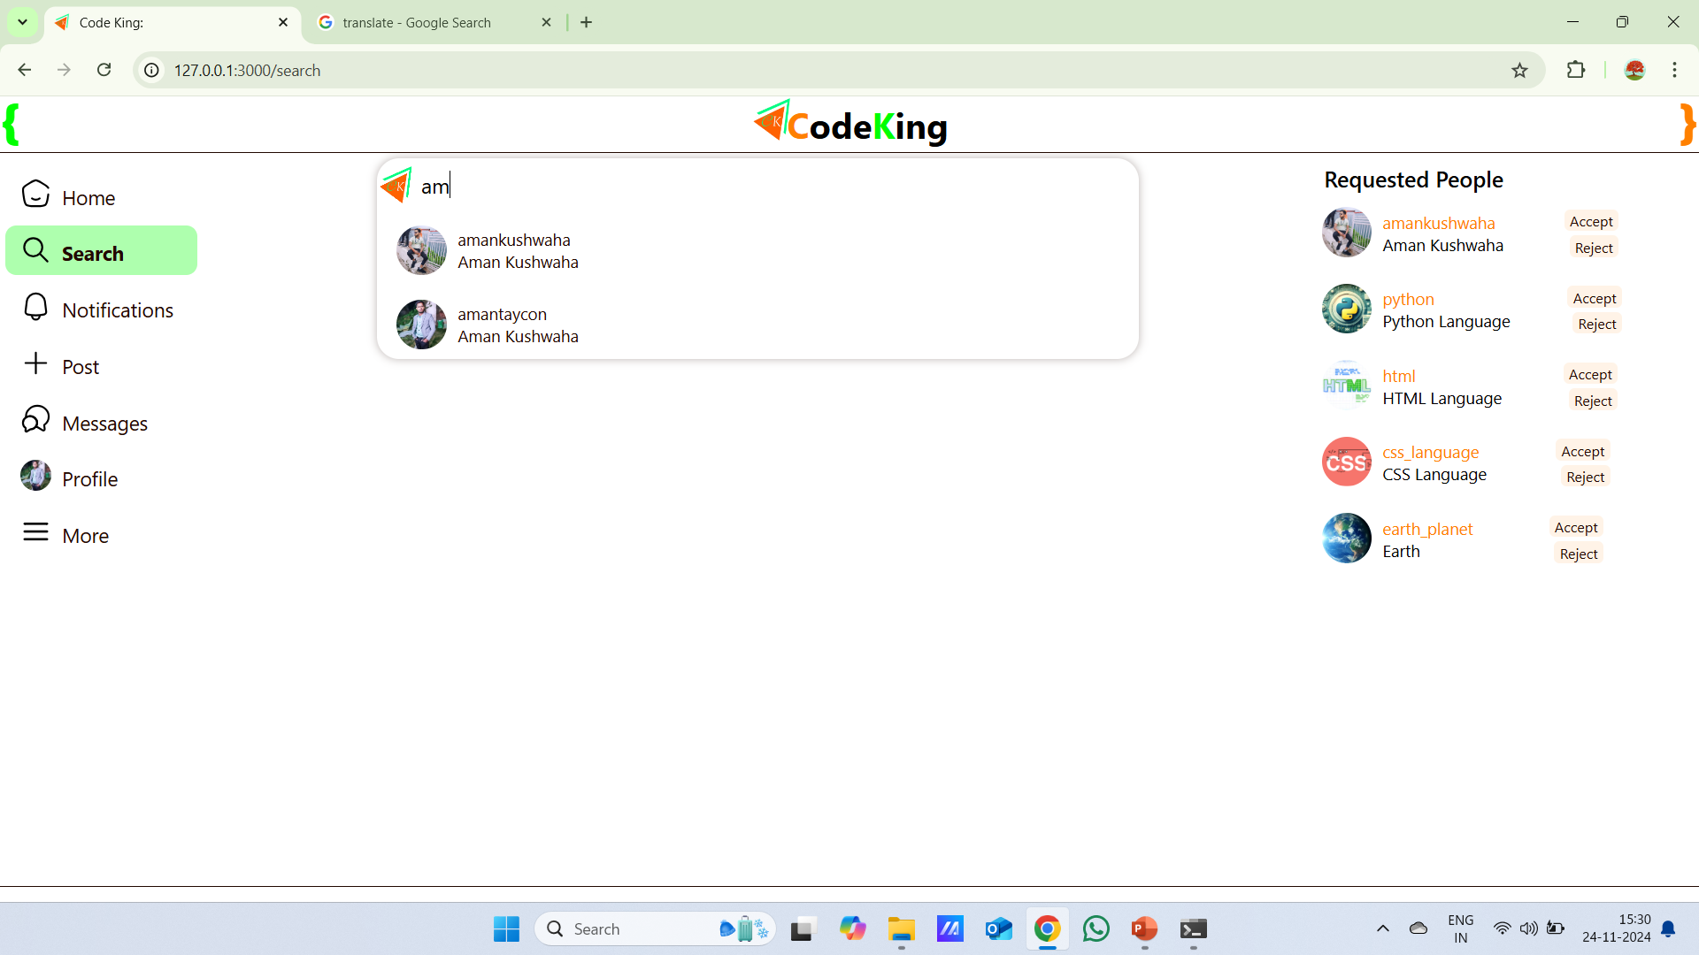
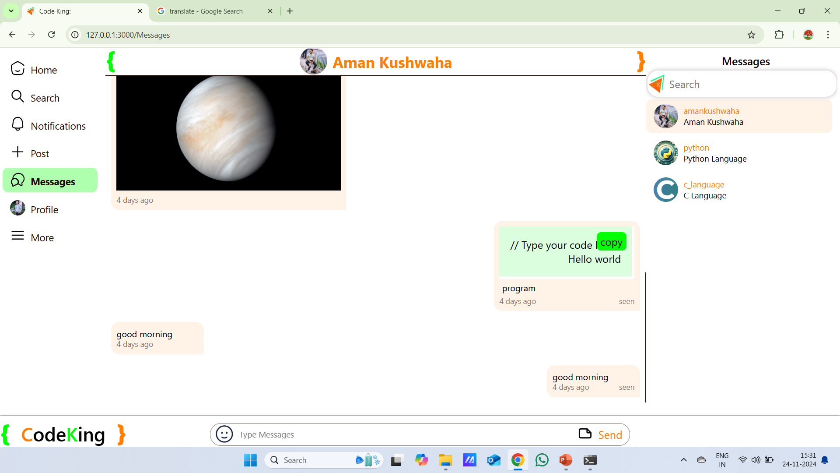
Modules 4 & 5
Search & Discovery
Live Chat
Advanced search for users, projects, and posts based on keywords
Help users discover relevant content and connect with like-minded developers
A real-time chat module for instant communication between coders, facilitating collaboration and knowledge sharing.

Slide 13
Workflow/Gantt Chart
Phase 1: Planning & Requirement Gathering (Week 1)
Identify platform features and define user requirements.
Create project roadmap and architecture.
Phase 2: Design (Week 2)
Design wireframes and user flows.
Develop mockups and prototypes.
Phase 3: Frontend Development (Week 3-4)
Implement HTML, CSS, JavaScript, jQuery for UI components.
Ensure responsive design.
Phase 4: Backend Development (Week 4-5)
Set up Local server, database (Node.js, Express, MYSQL).
Develop APIs for user management, posts, and messaging.
Phase 5: Testing & Debugging (Week 6)
Conduct unit and integration testing for both frontend and backend.
Bug fixing and performance optimization.
Phase 6: Deployment & Launch (Week 7)
Deploy on Any Platform.
Final testing in a live environment and launch.

Slide 14
Reports
Project Name: CodeKing – A Social Media Platform for Coders
Objective: To create a dedicated platform for developers to connect, share ideas, and collaborate on coding challenges in a social, creative environment.
Key Features:
User authentication and profile management
Post sharing for code snippets, tutorials
Real-time messaging
Search and discovery for finding content and developers
Technologies Used:
Frontend: HTML5, CSS, JavaScript, jQuery
Backend: Node.js, Express.js, MYSQL
Current Status:
Notification Module development in progress
Testing scheduled for next phase
Next Steps:
Finalize testing and bug fixes
Deploy in Localhost and launch beta version

Slide 15

References
Web References
Stack Overflow: https://stackoverflow.com
GitHub: https://github.com
Developer Mozilla (MDN Web Docs): https://developer.mozilla.org
Research Papers
"A Study on Social Media Platforms for Developers" (IEEE, 2020).
"Design Thinking for Software Development Projects" (Springer, 2021).
Tools and Frameworks
Node.js Documentation: https://nodejs.org/en/docs/

